Slide 1
INTERNET SERVICE OFFERS (INFO 570 DATA WRANGLING)
Joanna Rendon Ospina Matthew Naranjo

Slide 2
INTRODUCTION
The demand for remote work has skyrocketed which has also raised the pressure for reliable internet connection. Internet service providers now have a newly-found opportunity to expand their market share increasing their customer base. High-speed internet is a vital tool for all the industries with remote workers.
Today the number of internet users in the US is 307.2m and internet user penetration is estimated at 91.8% (Statista Research Department, 2022). However, according to Bloomberg, the digital divide is much larger than previously thought and high-speed internet coverage hasn’t reached 42mln vs 21.3mln people reported by the Federal Communications Commission (Poon, 2020).
This project aims to identify the best internet service provider based on speed, price and location ensuring that remote workers have high-speed and reliable internet. Additionally, the project will help people to know the price of internet plans beforehand and companies can negotiate deals with the provider of interest (based on worker location). And finally, we will check if a particular person is going Fiber or Not Fiber based on other attributes like speed_up, speed_down, state, among others.
Notes:
Reference:
Poon, L. (2020, February 19). Where the U.S. underestimates the digital divide. Bloomberg.com. Retrieved December 18, 2022, from https://www.bloomberg.com/news/articles/2020-02-19/where-the-u-s-underestimates-the-digital-divide
Statista Research Department. (2022, October 18). Topic: Internet usage in the United States. Statista. Retrieved December 18, 2022, from https://www.statista.com/topics/2237/internet-usage-in-the-united-states/#topicOverview

Slide 3




DESCRIBING DATASET
The data for address-specific internet offers was gathered by reporters Leon Yin and Aaron Sankin across dozens of US cities. The data includes offers by 4 internet service providers: Earthlink, Centurylink, Verizon, and AT&T and can be accessed here:
https://www.kaggle.com/datasets/michaelbryantds/internet-speeds-and-prices?select=speed_price_att_other_cities.csv
The following 5 data files have been merged and used for the analysis:
-speed_price_att.csv
-speed_price_att_other_cities
-speed_price_centurylink
-speed_price_earthlink
-speed_price_verizon
The total number of columns and rows after the files were merged constitute:
number of columns = 34
number of rows = 1,500,880

Slide 4
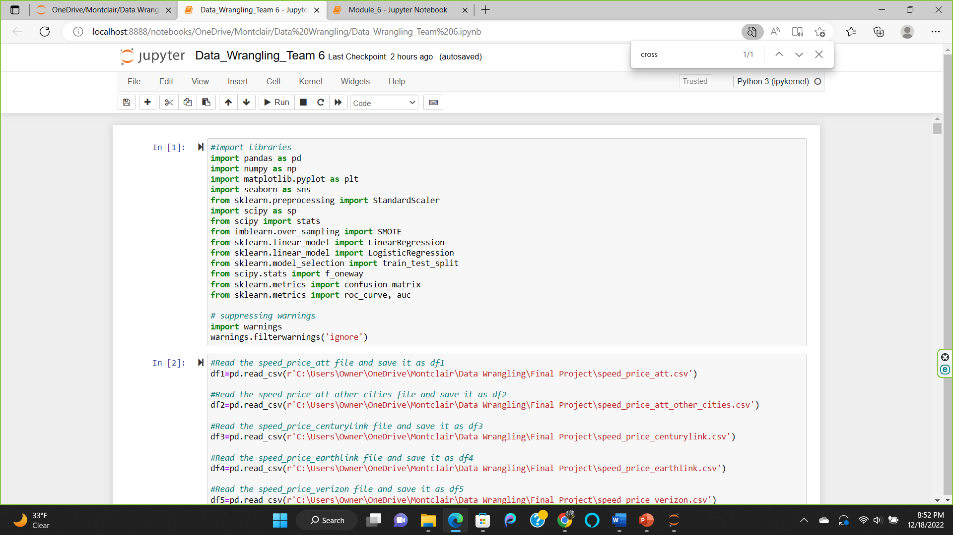
DESCRIBING DATASET
The following libraries were imported to Jupyter Notebook to undertake data analysis:
Our target variable is Technology. We verified that this variable has 4 levels (Fiber, Not fiber, Copper and NAN). We grouped the data into 3 levels:
Fiber
Not Fiber
Unknown (for NULL values)
We selected top 5 manufacturing states (CA, TX, IL, OH, NY) because we expect them to have reliable internet service for good industry performance.

Slide 5
DESCRIBING SELECT COLUMNS
COLUMN | DESCRIPTION
address_full | The complete postal address of a household we searched.
state | The state that the address is in.
provider | The internet service provider.
speed_down | Cheapest advertised download speed for the address in megabits per second (Mbps).
speed_up | Cheapest advertised upload speed for the address in megabits per second (Mbps).
price | The cost in USD of the cheapest advertised internet plan for the address.
technology | The kind of technology (fiber or non-fiber) used to serve the cheapest internet plan.
fastest_speed_price | The advertised upload speed of the fastest internet package for the address.
Internet_perc_broadband | The percentage of the population that is already subscribed to broadband in an addresses’ Census block group expressed as a proportion.
* The table lists only select columns; the full list of variables can be accessed through the source website.

Slide 6
DESCRIPTIVE ANALYSIS
VARIABLE NAME | MISSING (%)
speed_unit | 20.45
price | 20.88
technology | 20.88
package | 20.88
redlining_grade | 53.46
Income_lmi | 6.35
ppl_per_sq_mile | 3.35
n_providers | 3.35
income_dollars_below_median | 6.35
Internet_perc_broadband | 0.17
closest_fiber_miles | 68.74
NUMBER OF COLUMNS | NUMBER OF ROWS
34 | 1,500,880
VARIABLE NAME | MISSING (%)
address_full_closest_fiber | 68.74
lat_closest_fiber | 68.74
lon_closest_fiber | 68.74
availability_status | 97.76
geoid | 97.76
contract_provider | 72.90
in_service | 81.17
* Variables not listed in the table have 0% missing values.

Slide 7
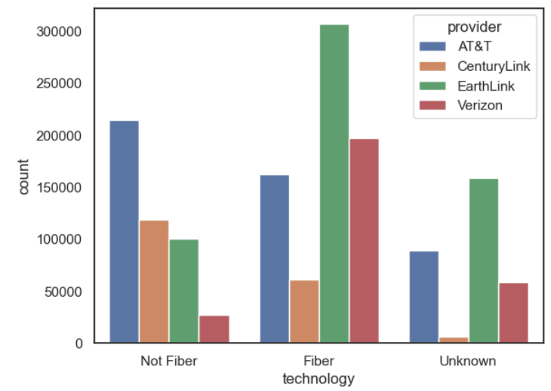
DESCRIPTIVE ANALYSIS (CONT’D)
The bar graph describes the ranking of each Internet Service Provider (i.e. AT&T, Verizon, CenturyLink, Earthlink) by the type of technology. As can be seen, Verizon offers most of its internet plans using Fiber technology. AT&T and CenturyLink are in the process of changing from Not Fiber to Fiber technology. EarthLink is more focused on Fiber than in Not Fiber.
Fiber (%) | 48.43%
Non-fiber (%) | 30.70%
Unknown (%) | 21.00%

Slide 8
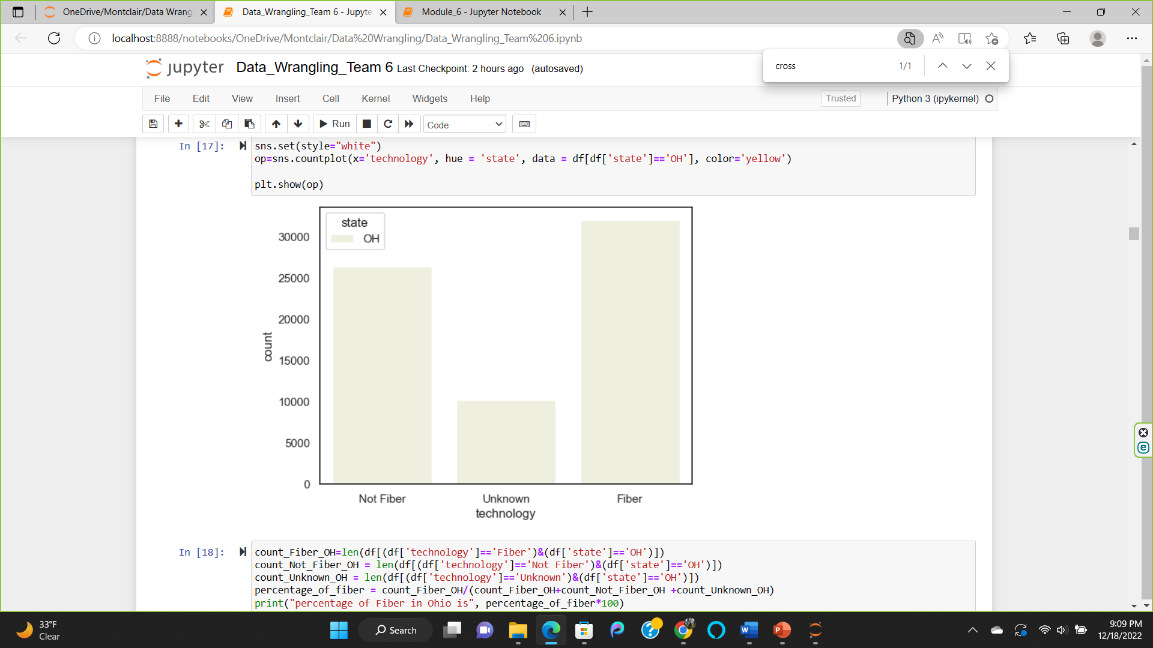
Fiber Vs Non-Fiber Vs Unknown
Fiber optics are faster and have more stable connection. We plot Technology per state to see which states are better for companies.
We selected top 5 manufacturing states (CA, TX, IL, OH, NY) to prove our hypothesis that these states have better internet connectivity.
In this graph we are running a test to count the number of Fiber vs Not fiber vs Unknown internet connections for the state of Ohio.
Fiber = 46.66%
Not Fiber = 38.49%
Unknown = 14.84%
It is surprising that the Fiber and Not Fiber percentage are almost the same, meaning this state doesn’t have reliable internet across the state. It will depend on address.

Slide 9
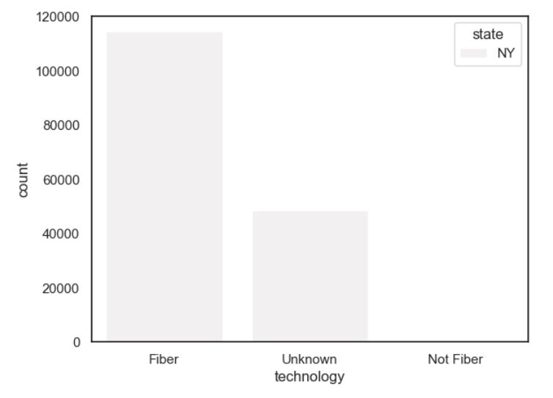
Fiber Vs Non- Fiber Vs Unknown
In this graph we are running a test to count the number of Fiber vs Not fiber vs Unknown internet connections for the state of New York.
Fiber = 70.12%
Not Fiber = 0.07%
Unknown = 29.80%
As expected, New York has transitioned to Fiber optic internet service across its territory.

Slide 10
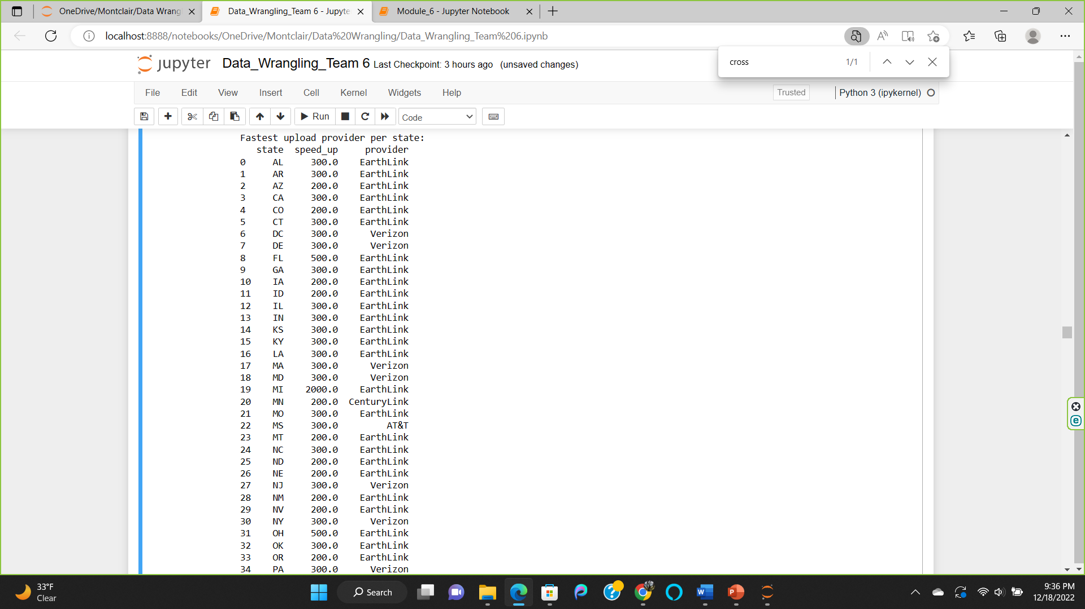
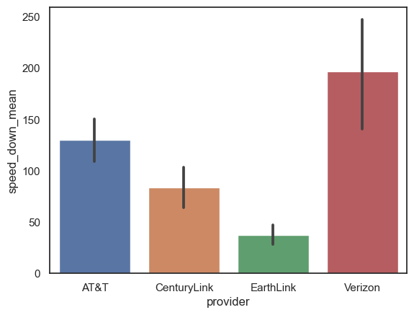
Fastest Internet Provider
The chart shows the fastest internet provider based on average upload speed. Verizon is the fastest internet provider in general. However, it will change from one state to another.
Provider:
AT&T 108.387441
CenturyLink 68.627156
EarthLink 26.870363
Verizon 207.882375
When we checked the maximum upload speed per state, Earthlink is the fastest provider in most states.

Slide 11
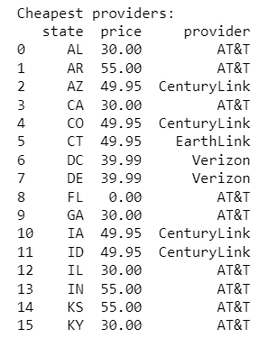
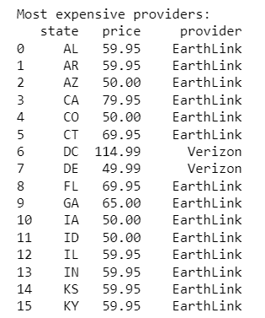
Cheapest and Most Expensive providers per state
The following information was pulled to check the cheapest and most expensive providers per state. In terms of price and provider, our top 5 manufacturing states of NY, OH, CA, IL, TX have:
CA, OH, TX, IL: $30 (AT&T) cheapest provider
and for NY it is $39.99 (Verizon).
CA: $79.99 (Earthlink) most expensive
OH: $65.00 (Earthlink)
NY: $114.99 (Verizon)
TX: 59.95 (Earthlink)
IL: $59.95 (Earthlink)
Most manufacturing states have AT&T as the cheapest provider and Earthlink as the most expensive provider. It is surprising to see that Verizon in NY offers the cheapest and most expensive package at the same time which might be due to outliers.

Slide 12
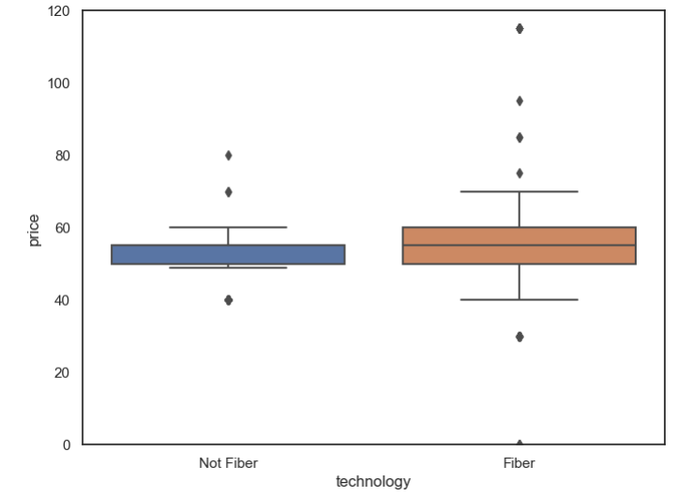
PRICE FOR FIBER VS NOT FIBER
The median price of Fiber internet service is higher than the of median price of Not Fiber. The results of Fiber are more spread than Not Fiber due to broader range, hence plans can be cheaper or more expensive than Not Fiber.
Even though we see that for Fiber, the minimum price is $0 and maximum price is $115, they are outliers because they are not within the range.
The Fiber group has more outliers than the Not Fiber group that must be handled to avoid inaccuracies.
75th percentile of Not Fiber is almost the same as 50th percentile of Fiber.

Slide 13
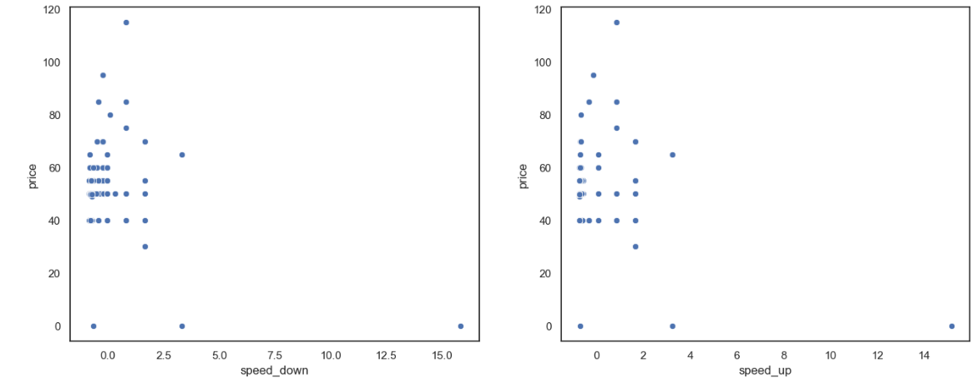
Price and speed_up & speed_down relationship (doesn’t show high correlation)

Slide 14
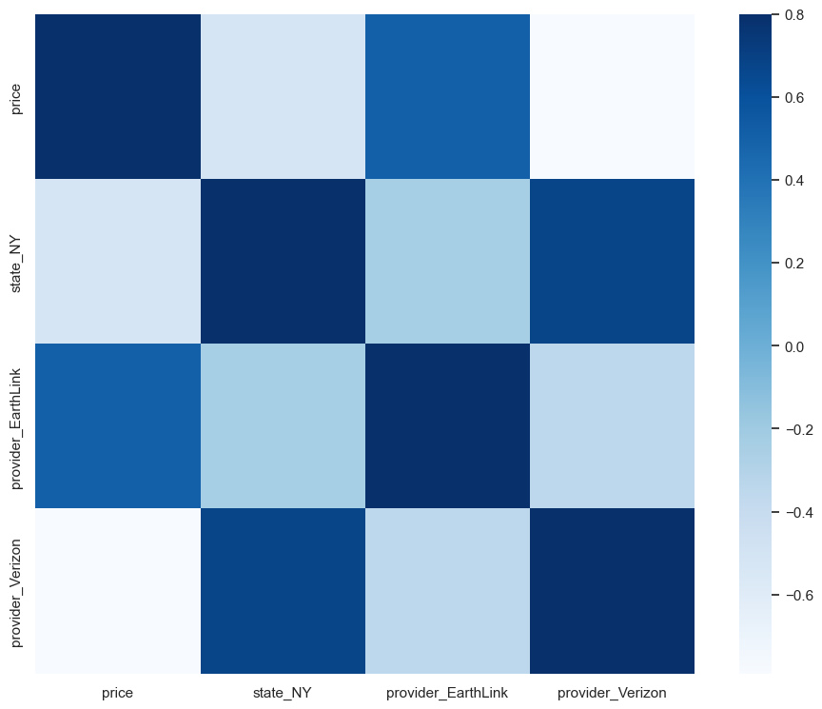
Correlation Matrix
The model has the aim of finding the price of an internet package using all the variables in the Data Frame.
The correlation matrix showed that State_NY, provider_Earthlink and provider_Verizon have higher influence in determining the price.
The darker squares indicate a stronger correlation between the two variables being tested.
We selected State_NY and provider_Verizon as our variables for the multiple regression.

Slide 15
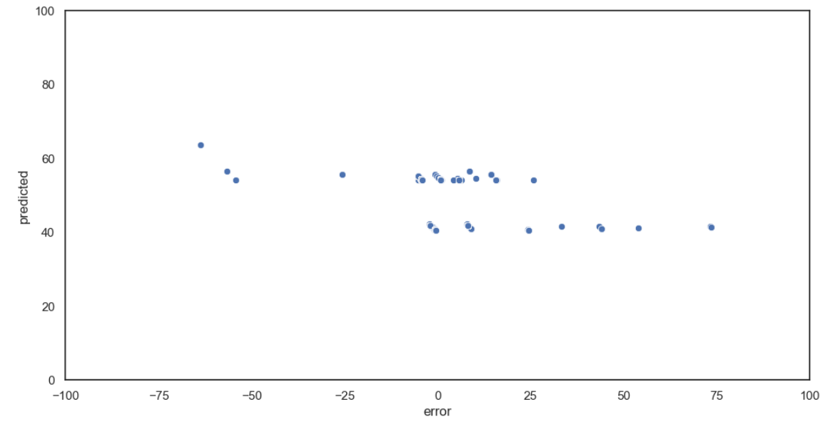
Multiple Linear Regression
Target variable = Price
Input variables = the provider (Verizon), speed_up, and State_NY.
The predicted price when the provider is not Verizon, the upload speed of the Internet plan is 50 Mbps and the client is in the state of New York, is $84.56.
The scatterplot assessed the actual price vs the predicted price, we found that if the price is within the $40-$60 range, we might see an error of up to $0.75.

Slide 16
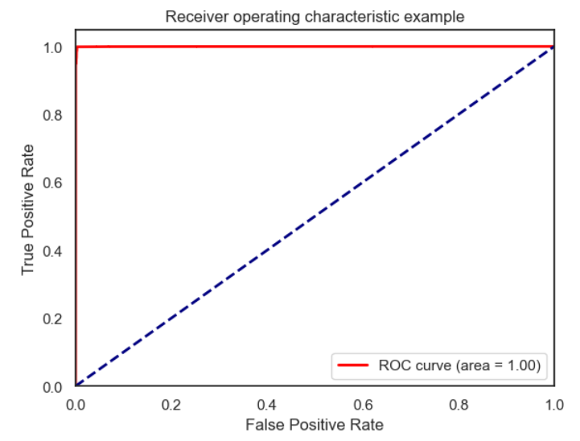
Logistic Regression
Target variable=Technology_Fiber
Input variables = set(df.columns) - set(['technology_Fiber'])
The logistic regression model has 2 classes: 0=Not Fiber and 1= Fiber. We used ROC curve to evaluate the model.
Because ROC_auc =0.99, the model is good.
The curve is over the prediction line which means the model is working better than the random prediction.

Slide 17
Implications and advantages
Based on this research Project, companies will be better equipped with information on which locations have reliable, high-speed internet service for their remote workers. Companies will also have leverage to negotiate bundles for internet and other related services with the best provider according to the locations where most of the employees reside.
The providers can use our findings to evaluate their position against their competitors and decide if they can base their strategy based on reliability and not just pricing.
The Sales teams of each provider can start targeting customers where they don’t have sufficient representation to onboard new customers.
Our Project investigates the transition and upgrades to a newer, more modern technology and is evaluated from the viewpoint of both demand and supply. Previously, price was determined based on speed, but nowadays it is based on the provider, location, download and upload speed. Our research combines all variables and is exhaustive.
The two models developed as part of this Project reflect those changes and one of those can tell the price of a new internet package and the other one will tell the technology used.
Moving forward this information can be used as a basis on how Sales Team should start targeting different areas, since some models were not as effective. This is an indicator that the Sales Team should change some of their tactics.

